Slide 2
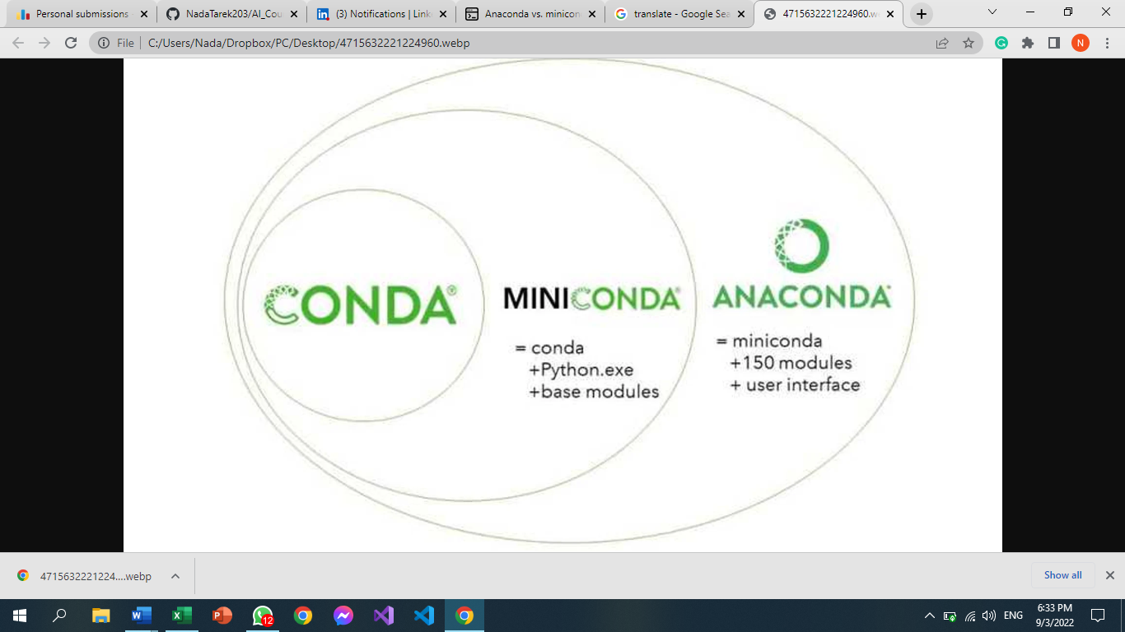
Session 3
30/8/2022
Task 1:
What is miniconda & what is the difference between it an anaconda ?[1]
Miniconda is a free minimal installer for conda. It is a small, bootstrap version of Anaconda that includes only conda, Python, the packages they depend on, and a small number of other useful packages, including pip, zlib and a few others.
There are essentially two main differences:
Number of packages: Anaconda comes with over 150 data science packages,
whereas miniconda comes with only a handful.
Interface: Anaconda has a graphical user interface (GUI) called the Navigator,
while miniconda has a command-line interface.

Slide 3
Task 2:
Not clean code and someone who optimized it into a clean code
Meaningful names
Bad: var d
Good: var elapsedTimeinDays
Avoid Disinformation
Bad: var accountlist=[]
Good: var accounts=[]
Use Searchable Names
Bad: if (student.classes.length<7) //do something
Good: if (student.classes.length<MAX_CLASSES_PER_STUDENT) //do something

Slide 4
Task 3:
What is the framework and its benefits ?[2]
A framework is a structure that you can build software on. It serves as a foundation, so you're not starting entirely from scratch. Frameworks are typically associated with a specific programming language and are suited to different types of tasks.
Let's say you're building a house. You could pour the foundation and frame the house yourself. It would take a lot of time, but you could do it. If all of that were already done for you, though, it would save you quite a bit of effort — especially if it was done by expert home builders.
In software development, a framework serves a similar purpose. It's designed and tested by other Software Developers and Engineers, so you know it's a solid foundation.
A house isn't complete with just the framework, though. Similarly, a framework in software development is a starting point, but you add higher-level functionality to it to make it work.
Its benefits:
Saving software professionals time and energy.
More Secure.
Allowing coders to focus on tasks more specific to their project.
Creating clean and adaptable code.
Avoid duplicate Codes.

Slide 5
Task 4:
What is the most popular processors in pc and smartphones?
In pc:
Intel Core i7-12700H
Intel Core i9-12900H
Intel Core i7-12800H
AMD Ryzen 7 6800H
Intel Core i5-12500H
In smartphones:
Apple A15 Bionic
Dimensity 9000 Plus (Media Teck)
Snapdragon 8 Plus Gen1
Dimensity 9000 (Media Teck)
Snapdragon 8 Gen1
Task 5:
How to make Recursion faster than iteration on a processors that doesn’t support multithreading?
By Using Memoization

Slide 6
Task 6:
what is hashtables ? why we use hash tables in unordered list? [3]
A hash table is a type of data structure that stores key-value pairs. The key is sent to a hash function that performs arithmetic operations on it. The result (commonly called the hash value or hash) is the index of the key-value pair in the hash table.
Task 7:
how to print the error type for the user in try catch?[4]
Try:
Somefunction()
Except Exception as ex:
Template="An exception of type {0} occurred. Arguments:\n{1!r}“
Message=Template.format(type(ex).__name__,ex.args)
Print(Message)
Example:
Let table Size=7
ab,27 1 1
a=0, b=1, a+b=1, 1% table Size =1
to prevent duplication in hash values:
bdb=1*26*26+3*26+1=755%7=6

Slide 7
References:
https://www.educative.io/answers/anaconda-vs-miniconda htt ps://www.techopedia.com/definition/27857/thread-operating-systems
https://www.codecademy.com/resources/blog/what-is-a-framework
https://www.educative.io/answers/what-is-a-hash-table
https://stackoverflow.com/questions/9823936/how-do-i-determine-what-type-of-exception-occurred

